Slide 1
Conformational Sampling to
Interpret SAXS Profiles
October 2013
Patrick Weinkam
Sali group @ UCSF

Slide 2
Outline
- Background and Integrative Modeling Platform (IMP)
AllosMod-FoXS for interpreting SAXS profiles:
structure -> SAXS profile -> ensemble enumeration ->
-> cluster analysis
Mapping allosteric states and mechanisms

Slide 3
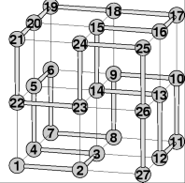
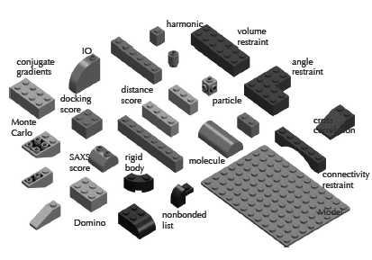
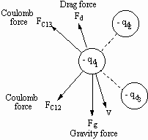
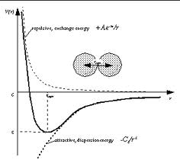
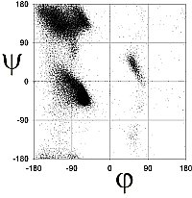
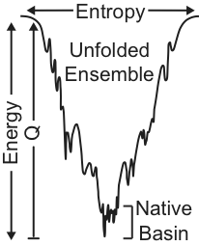
Universe of Dynamics/Structure Modeling
Implicit
Experiment
Few Parameters
and
Efficient
Top-Down
Implicit
Physics
Some
Experiment
Experiment
Detailed
but
Expensive
Bottom-Up
Integrative
Some
Physics
Physics
Generalization
of Experimental
Data

Slide 4
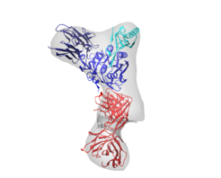
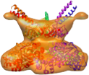
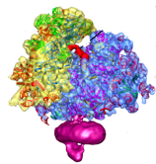
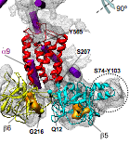
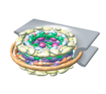
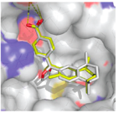


IMP: Modeling assemblies
26S proteasome
PCSK9-Fab
ribosome
NPC
HSP90
RyR1
RXRa
member
positions
member
orientations
atom positions
residue positions
Need to be able to simultaneously process structure on all these scales.
Notes:
many large assemblies which play important roles in key processes in the cell

Slide 5
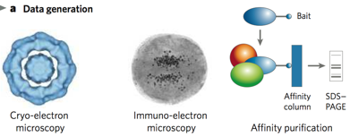




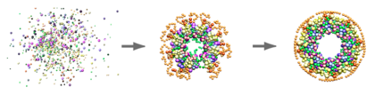


IMP Work Flow
Gathering information
Designing model representation and evaluation
Sampling good models
Analyzing models and information
Alber et al. Nature 450, 683-694, 2007
Robinson, Sali, Baumeister. Nature 450, 974-982, 2007
Alber, Foerster, Korkin, Topf, Sali. Annual Reviews in Biochemistry 77, 11.1–11.35, 2008
Russel et al. PLoS Biology 10, 2012
Notes:
and here is one way to actually put all the data together.
a simple way to describe it is as a generalization of protein structure determination by NMR spectroscopy.
4 stages, potentially an iterative conversion of input datasets into the structures consistent with them:
1. data generation, open minded about where to get it from; implicitly or indirectly informative is fine at this stage
2. representation: defines components of the system. the representation and its resolution depends on the available data (eg, point per atom; point per residue, etc). option to use a hierarchical representation is good. flexibility in representation options facilitates conversion of data into restraints.
restraints: specification of what configurations of system components are consistent with the data. needs to encode uncertainty and ambiguity ((ideally all restraints need to be satisfied within their error bars, otherwise the balance between the restraints needs to be handled, which is much more difficult)).
3. sampling: powerful optimization schemes and computers needed
4. ensemble analysis: various outcomes: 0, 1, more than 1 solution; restraints satisfied or not. precision definitely, accuracy as much as possible; feeding into the next iteration.
benefits: synergy by design, generates all (as opposed to one) models consistent with the data, facilitates assessing the models and data, allows playing what if games and planning next experiments.
involves experiment and computation rather symmetrically (steps). In fact, this is formalization of the structural biology’s virtuous scientific cycle of experiment and hypothesis, where the hypothesis corresponds to the structural model.
This should ideally be practiced almost from an outset of a project on structure characterization, not towards the end when the data are judged to be already collected.
One more comment: we’ve seen a lot of integration of data at this conference, but it seems one distinction in the case of structural biology is that there is a clear explicit model that the integration of various data is supposed to inform - and that is the structural model of the system of interest. An evocative phrase is that we are “embedding” various data in 3 dimensions.

Slide 6






IMP and Web Servers
Simplicity
Chimera tools/
web services
FoXSDock
Flexibility
http://www.integrativemodeling.org/
http://salilab.org/imp/
http://salilab.org/foxs/
http://salilab.org/allosmod-foxs/
IMP C++/Python library

Slide 7
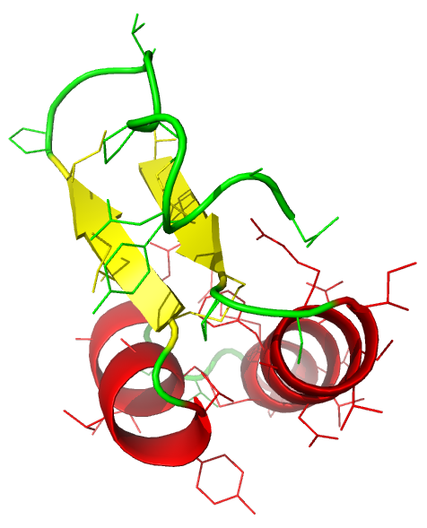
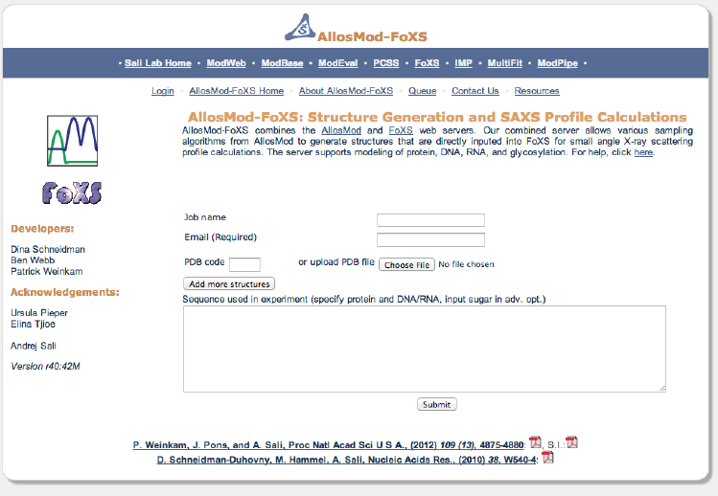
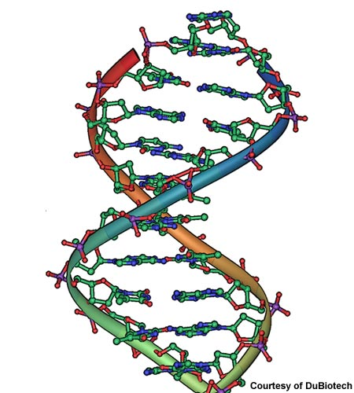
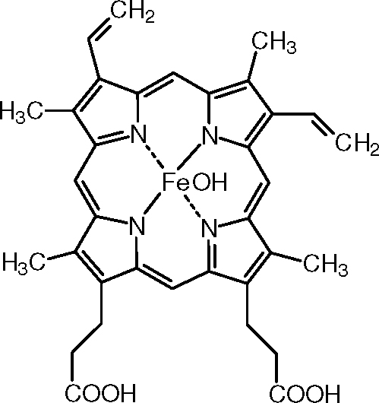
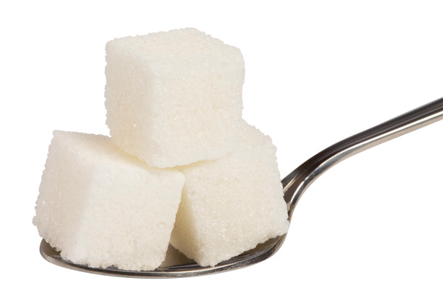
AllosMod-FoXS
INPUT: 1) sequence, 2) structure(s), and 3) SAXS profile
OUTPUT: 1) sets of structures, 2) their weights, and
3) their theoretical SAXS profiles
Weinkam et al. in preparation.

Slide 8
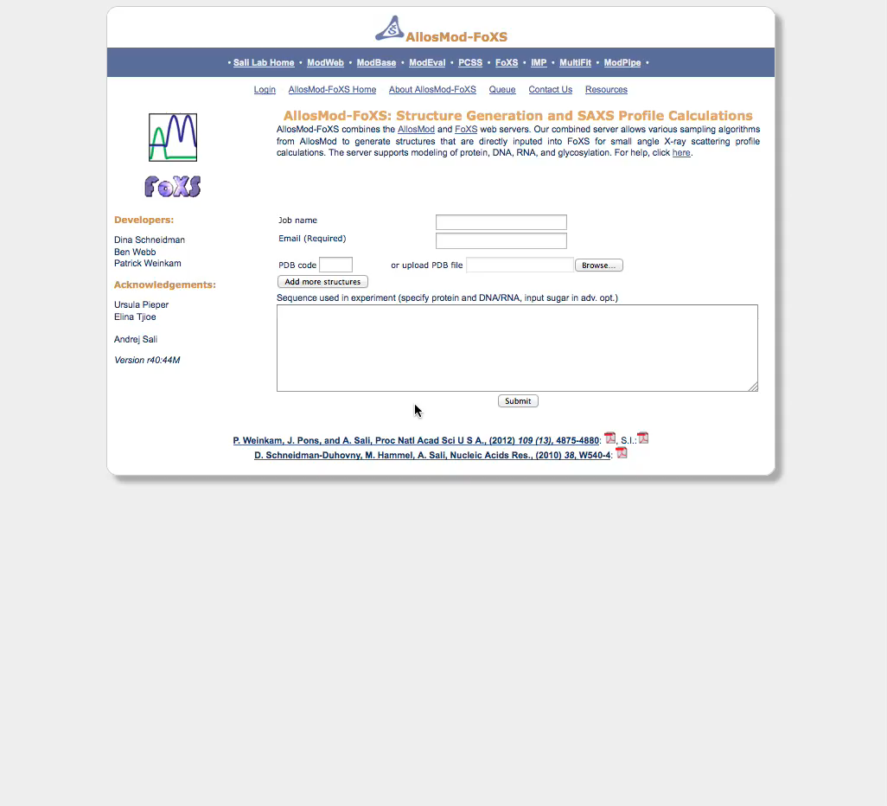
AllosMod-FoXS: DNA Ligase
Weinkam et al.
in preparation.

Slide 9
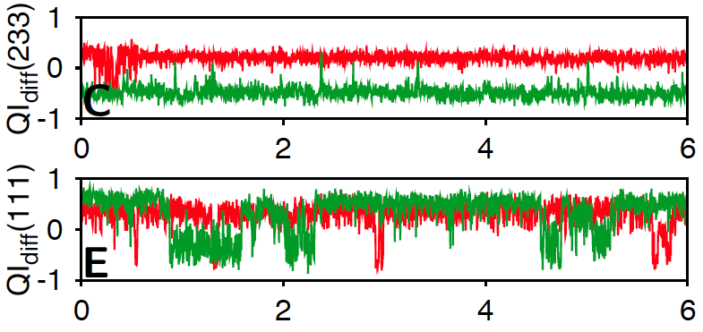
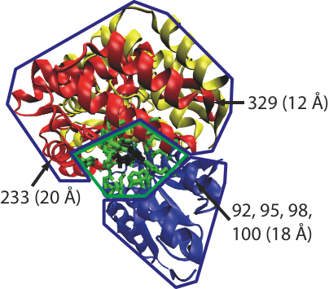
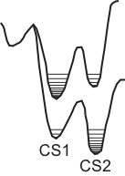


STEP 1: Conformational Sampling on Simplified Energy Landscapes
INPUT: effector bound
& unbound structures
AllosMod (2 templates)
AllosMod (1 template)
MODELLER
OUTPUT: simulation
trajectory
& structures
QI_{diff}(i)
time (ns)
Weinkam, Pons, Sali. PNAS 2012.

Slide 10
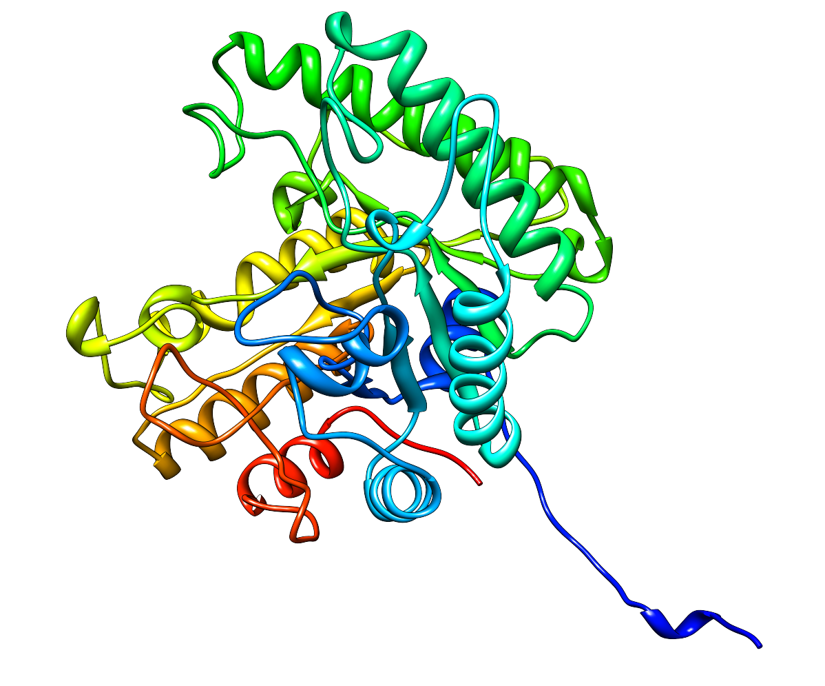
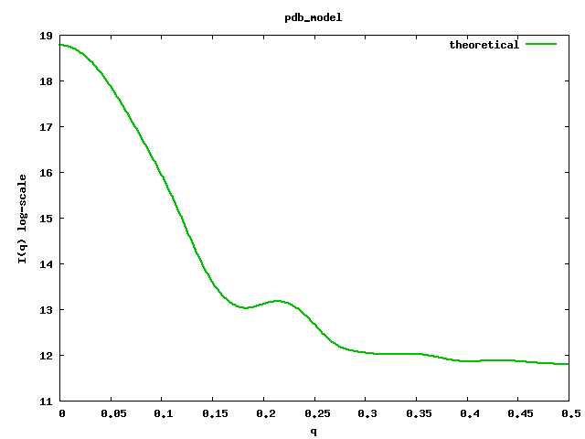
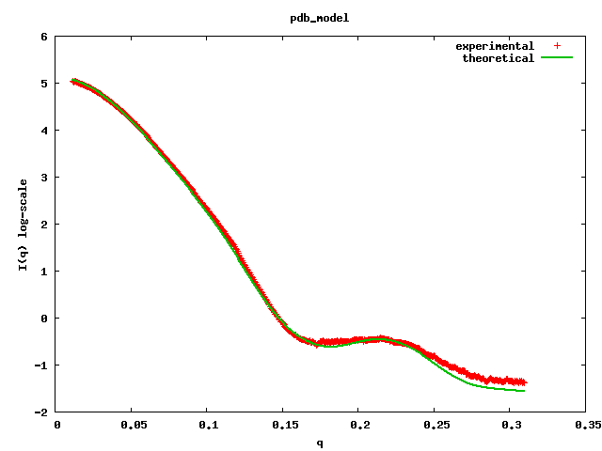
STEP 2: Calculate Theoretical SAXS Profiles
INPUT: experimental SAXS profile and a set of structures
OUTPUT: a computed profile fit to the experimental profile
Compute theoretical profile
(fast Debye formula)
Fit experimental profile
I(q)
I(q)
q
q
Repeat for each structure
Schneidman-Duhovny D, Hammel M, Sali A. NAR 2010
Schneidman-Duhovny D, Hammel M, Tainer J, Sali A. Biophys J 2013

Slide 11
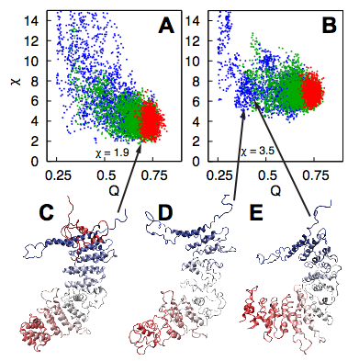
AllosMod-FoXS Sampling for Glomulin
Extensive conformational
sampling due to:
1) 3 sampling protocols
(red, green, and blue)
2) perturbed energy
landscapes
3) energies stored in
memory, large systems
(up to 6000 residues)
can be studied
Bound
Unbound

Slide 12
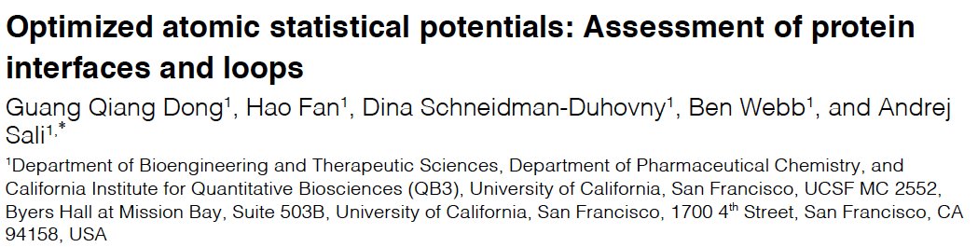
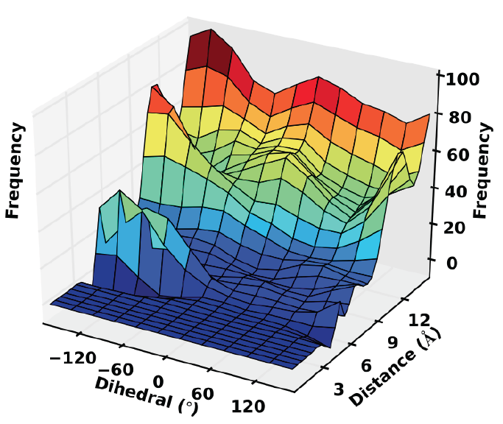
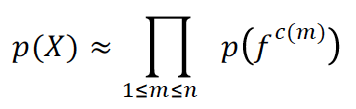

STEP 3: Profile Clustering and Filtering Using SOAP Statistical Potential
Bayesian Framework

Slide 13
STEP 4: Ensemble Enumeration
Debye formula
Enumerated Parameters
FoXS form factor
C₁ = atomic radii
c₂ = hydration layer density
s = scale
Ensemble fit equation
I = representative profile
from a cluster
w_{i} = weight of profile i
ensemble size from 2 to 5
Weinkam et al. in preparation.

Slide 14
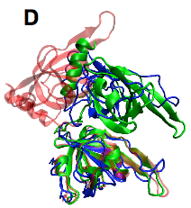
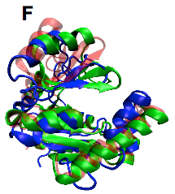
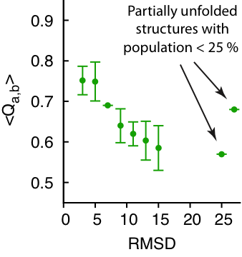
STEP 5: Structural Clustering and
Uncertainty Metrics
Simulated data with two states (red and green),
attempt to predict one of the states (green)
Blue: prediction
Red: input
Green: target
<Q_{a,b}> within top 10 predicted green
RMSD to green
Weinkam et al. in preparation.

Slide 15
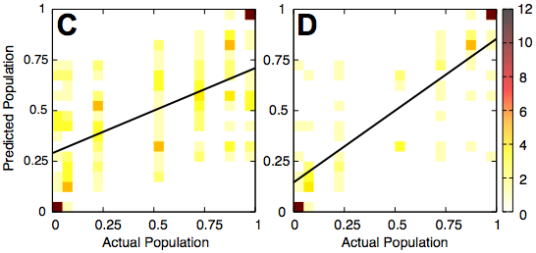
STEP 5: Structural Clustering and
Uncertainty Metrics
Simulated data with two states (red and green),
attempt to predict one of the states (green)
all predictions
σ_{weights} < 0.08
R = 0.59
R = 0.82
Weinkam et al. in preparation.

Slide 16
Causes of Uncertainty
1) Structural states are not easily differentiable by SAXS profiles
2) Conformational sampling errors
- all relevant states not sampled
- not all components of the system accounted for
- overfitting due to fitting random noise in the data
3) Incorrect number of states used to fit the SAXS profile
Weinkam et al. in preparation.

Slide 17
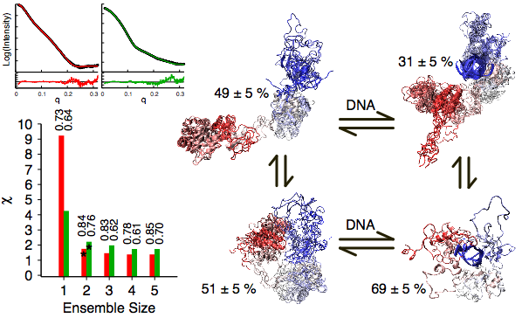
Ensemble Enumeration for DNA Ligase
Weinkam et al. in preparation.

Slide 18
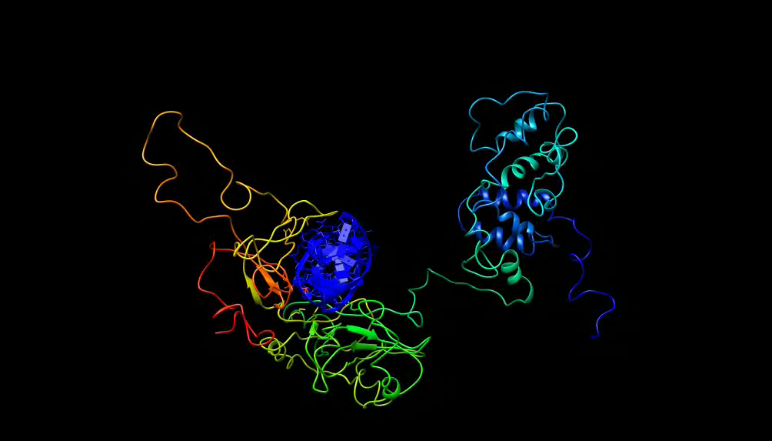
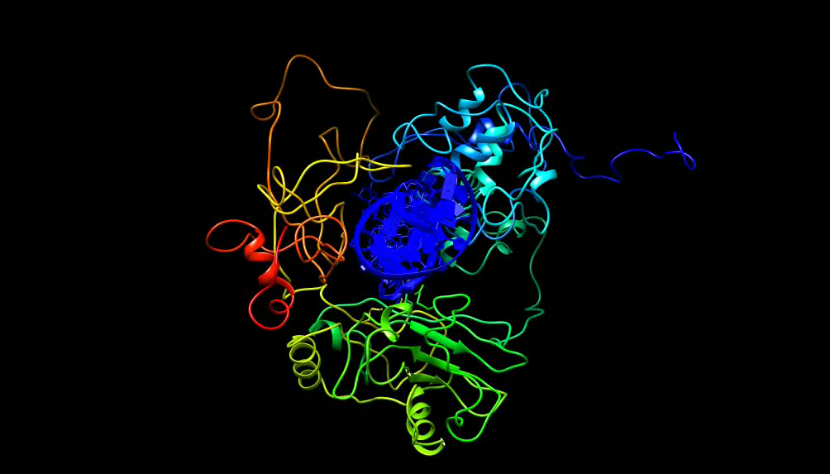
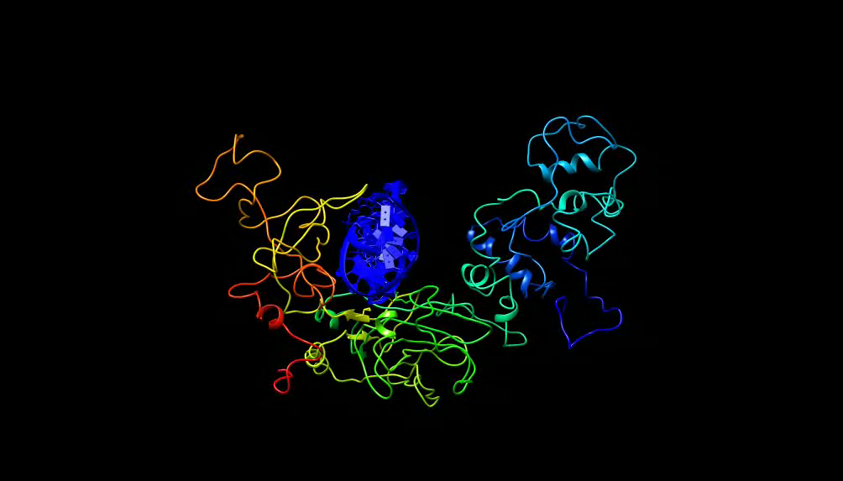
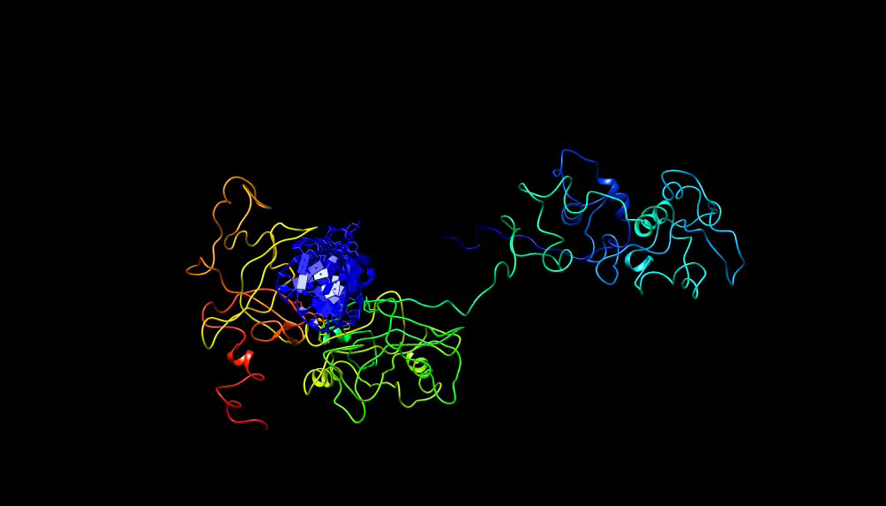
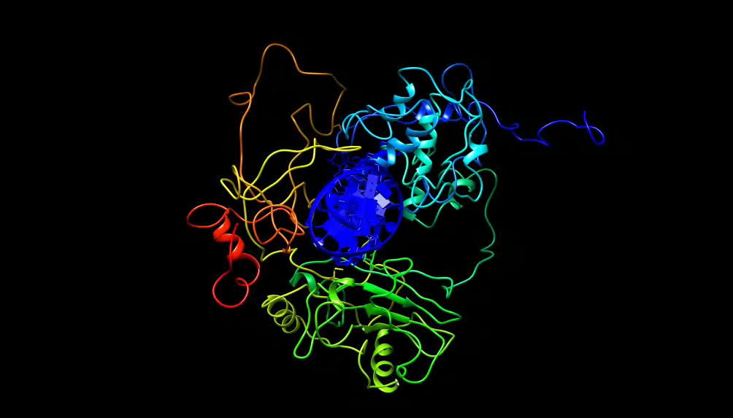
Ensemble Enumeration for DNA Ligase
Structures from two state fit (𝑥 = 2.1):
69 ± 5 %
31 ± 5 %
Structures from three state fit (𝑥 = 1.9):
59 ± 7 %
23 ± 7 %
18 ± 5 %

Slide 19
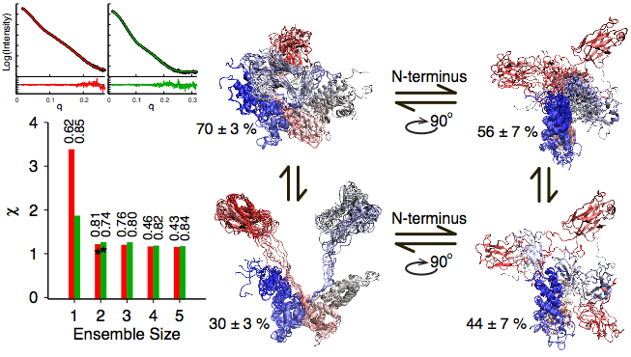
Ensemble Enumeration for Ubiquitin Ligase
Weinkam et al. in preparation.

Slide 20
Conclusions
- AllosMod-FoXS provides an intuitive user experience to
model macromolecular structure measured by a SAXS
profile, including:
1) allostery, 2) HIS tags or missing loops, 3) glycosylation
Updates in the next few weeks to improve visualization
of the results
Integrate SAXS with other experimental approaches!
If you use our servers and have any questions or helpful
comments, please let us know!

Slide 21
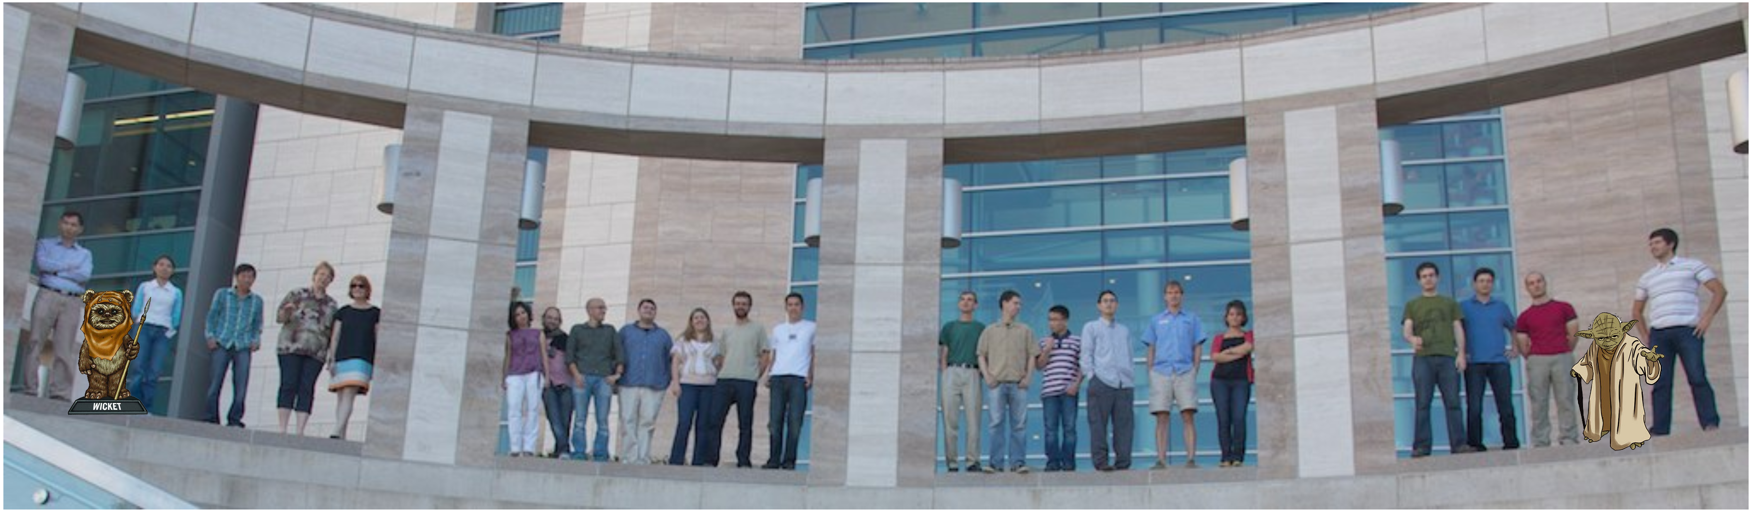




Acknowledgments
Andrej Sali
Jaume Pons
Yao-Chi Chen
Peter Cimermancic
Guangqiang Dong
Miklos Guttman
Michal Hammel
Seung-Joong Kim
Riccardo Pellarin
Ursula Pieper
Dina Schneidman
Elina Tjioe
Ben Webb

